Slide 1

Introduction to Computational Text Analysis
Prof. Sebastián Vallejo Vera

Slide 2
Who am I?
(All questions about my personal life are fair questions right now--and only now)

Slide 3
My first names is Sebastián; my last names is Vallejo Vera.
You can call me however you feel more comfortable: Sebastián, Professor Vallejo, Professor Vallejo Vera, Dr. Vallejo, and/or Dr. Vallejo Vera. Dr. Vera is my mom.
I received my PhD in 2019 from the University of Maryland, College Park (just like Dave). I am a comparativist and a methodologist.
Reach me at:
sebastian.vallejo@uwo.ca
www.svallejovera.com

Slide 4
My Research: Text Analysis
Application of Large Language Models (LLM) in the social science:
Timoneda, J.C., and S. Vallejo Vera. BERT, RoBERTa or DeBERTa? Comparing Performance Across Transformer Models in Political Science Text. Forthcoming Journal of Politics.
Davila Gordillo, D., J.C. Timoneda, and S. Vallejo Vera. Machines Do See Color: A Guideline to Classify Different Forms of Racist Discourse in Large Corpora. Working Paper.
Timoneda, J.C., and S. Vallejo Vera. Behind the Mask: Random and Selective Masking in Transformer Models Applied to Specialized Political Science Texts. Working Paper.

Slide 5
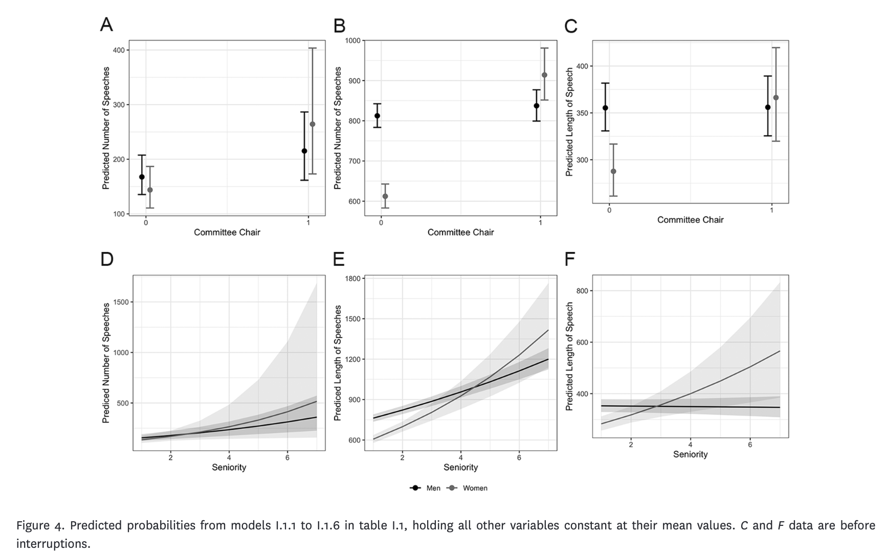
My Research: Gender and Politics
Vallejo Vera, S., & Gómez Vidal, A. (2022). The politics of interruptions: gendered disruptions of legislative speeches. The Journal of Politics, 84(3), 1384-1402.

Slide 6
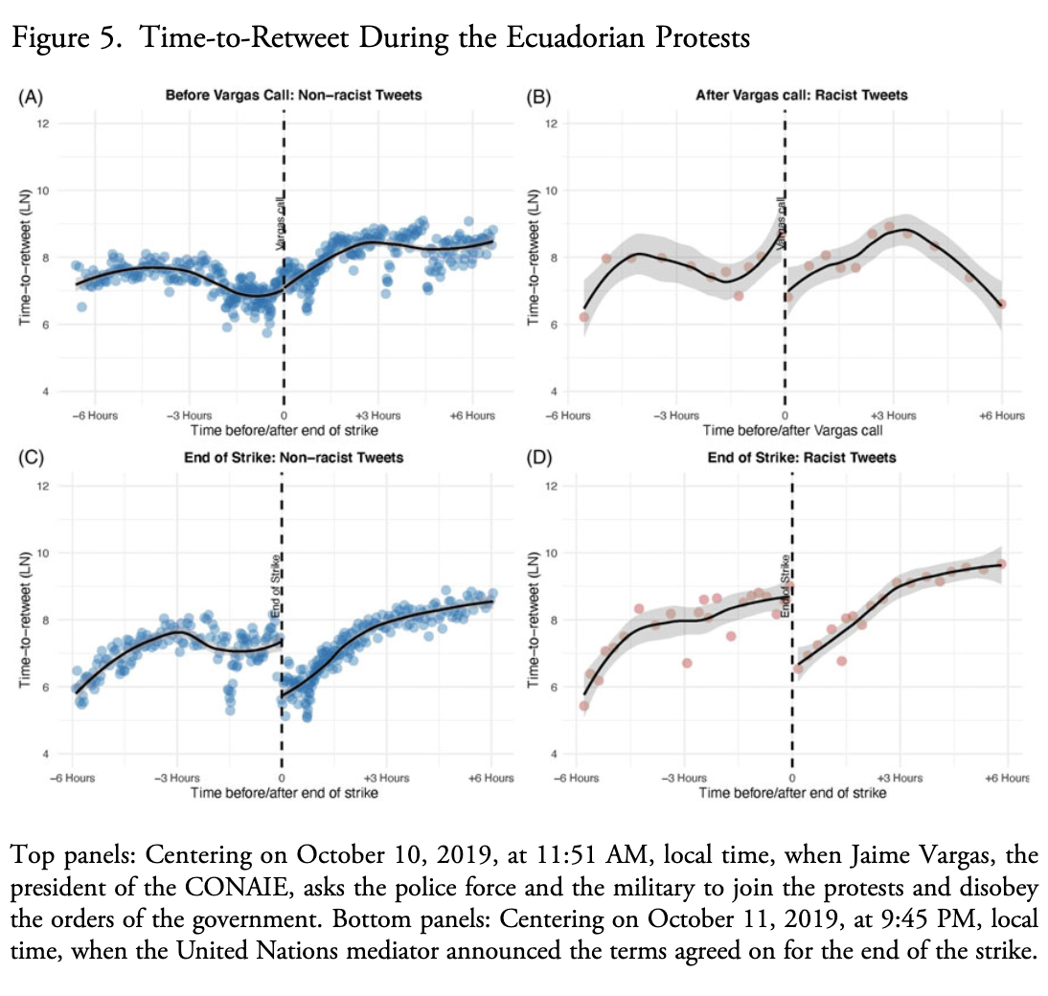
My Research: Racial Identity and Politics
Vallejo Vera, S. (2023). Rage in the Machine: Activation of Racist Content in Social Media. Latin American Politics and Society, 65(1), 74-100.

Slide 7
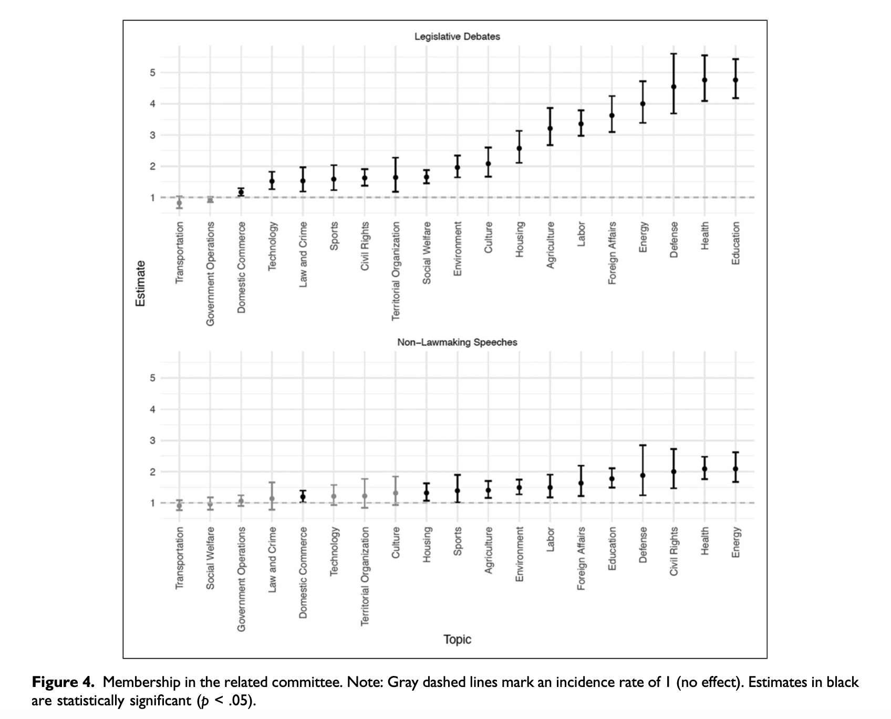
My Research: Legislative Politics
Alemán, E., Micozzi, J. P., & Vallejo Vera, S. (2023). Congressional Committees, Electoral Connections, and Legislative Speech. Political Research Quarterly, 76(2), 994-1011.

Slide 8
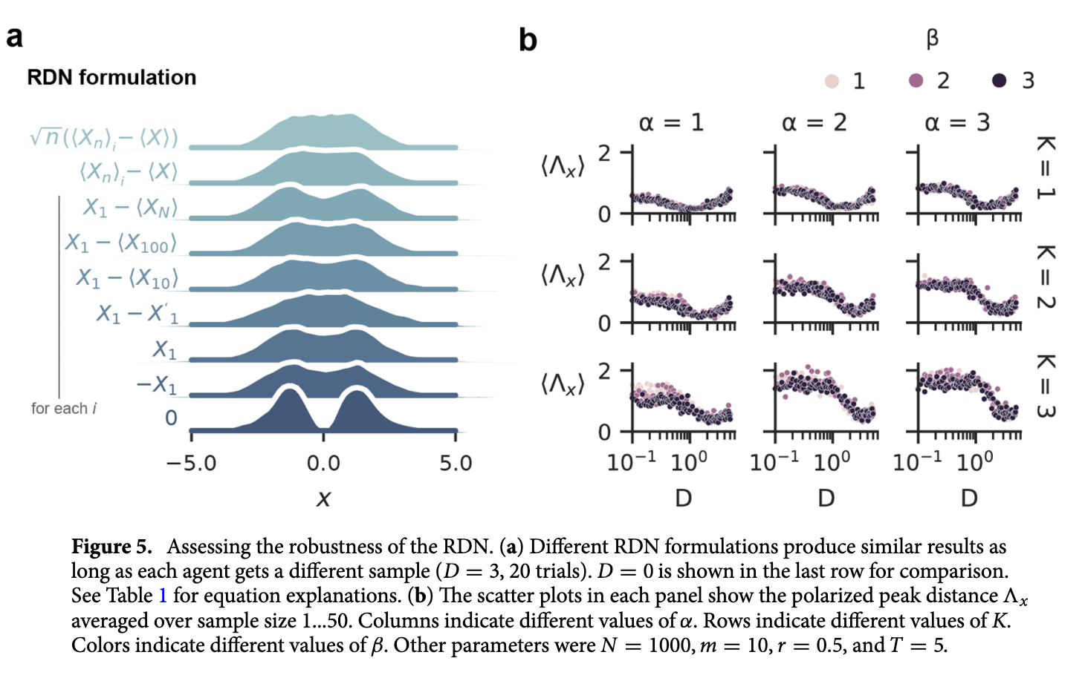
My Research: And then some…
Currin, C. B., Vallejo Vera, S., & Khaledi-Nasab, A. (2022). Depolarization of echo chambers by random dynamical nudge. Scientific Reports, 12(1), 9234.

Slide 9
Questions?

Slide 10
Who are you?

Slide 11
Name
Research Interest / Policy Interest
Why are you taking this course?
What is you R/Python/coding level?

Slide 12
Read the Syllabus
(also, you probably did not read the syllabus so when the class ends, please go read the syllabus)

Slide 13
What you MUST know from the syllabus

Slide 14
FAQs:
Must I be on time? Yes.
Can I come into the class if I arrive late? Yes, but quietly.
Must I come to class? No.
Do you want me to come to class? Should I come to class? Yes, and YES.
Will you grade class participation? No, but I want you to participate regardless.
Will all the slides and material for the class be made available to me? Yes!

Slide 15
Expectations during Class
Be kind.
Be respectful.
Avoid looking at your phone…

Slide 16
Course Requirements
(This is how capitalism turns you into a number)

Slide 17
Homework (40%): There will be four worksheets that will walk you through the implementation of different text analysis techniques. At the end of each worksheets, you will find a set of questions. You should partner up with someone else in your class and go through these together.
Reading Review (10%): On the weeks when no assignment is due, I will randomly choose a pair of students to briefly explain the research question and the method used in one of the assigned papers for that week.
Final Essay (40%): A 4000-word max essay. Further instructions can be found in the syllabus.

Slide 18
Readings

Slide 19
For all weeks, there are two types of readings: technical and applied.
For most weeks, the technical reading will be a chapter from Grimmer, Roberts, and Stewart’s book “Text as Data: A New Framework for Machine Learning and the Social Science”.
Mini-FAQ:
Should I do all the readings? Yes.
Should I do all the readings before class? If possible. However, some can be more challenging than others. I recommend that, at the very least, you carefully read the technical readings and one applied paper. If you run out of time, skim the rest and catch up when possible.
Ok, but do I really need to do all the readings? Yes, this is why…

Slide 20
Code

Slide 21
All the code in the class, as well as all the exercises for homework, can be found at the course’s webpage: https://svallejovera.github.io/cpa_uwo/

Slide 22
Perusall

Slide 23

TOUR!

Slide 24
Office Hours
(Do not suffer in silence)

Slide 25
Mondays from 13.00 to 14.00 or by appointment. Mostly by appointment.
You should come to office hours…

Slide 26
Closing remarks

Slide 27
I do not believe in punitive teaching. I believe that learning happens in community.
If you have questions, ask them. More often the not, other students have similar questions, so it helps everybody.
This program (and by extension, this class) is preparing you for a job/a PhD. Take advantage of it. It’s tough out there.
If you are a PhD student, this is you job!

